Slide 1
Real Time System
Lecturer: Er. Saroj ghimire
Qualification: Msc.CSIT, BE(COMPUTER)
Lincoln University College

Slide 2


Overview
Assumption on resource and their usage
Effects of resource contention and resource access control
Model of multiprocessor, distributed system

Slide 3
Objectives
Understand resources types and usages
Studying different multiprocessor and distributed model

Slide 4
Resources
A system has ρ types of resource R1, R2, …, R_{ρ}
Each resource comprises n_{k} indistinguishable units; plentiful resource have no effect on scheduling and so are ignored
Each unit of resource is used in a non-preemptive and mutually exclusive manner; resources are serially reusable
If a resource can be used by more than one job at a time, we model that resource as having many units, each used mutually exclusively
Examples of such resources are mutexes, reader/writer locks, connection sockets, printers, and remote servers
A resource that has an infinite number of units has no effect on the timing behavior of any job since every job can have the resource at any time

Slide 5
Access to resources is controlled using locks
Jobs attempt to lock a resource before starting to use it, and unlock the resource afterwards; the time the resource is locked is the critical section
If a lock request fails, the requesting job is blocked; a job holding a lock cannot be preempted by a higher priority job needing that lock
Critical sections may nest if a job needs multiple simultaneous resources

Slide 6
Assumption on resource and their usage
The system consists of only one processor
The system also contains p types of serially reusable resources named R1, R2 ---- R_{p}
There are v_{i} indistinguishable units of resources of type R_{i} for 1 ≤ i ≤ p
Serially reusable resources are granted to jobs on a non-preemptive basis and used in a
mutually exclusive manner
When a unit of a resources Ri is granted to a job, this unit is no longer available to other jobs until the job frees the unit
e.g. mutexes, reader/writer locks, connection sockets, printers
A binary semaphore is a resource that has only one unit while a counting semaphore has many units
e.g. a system containing five printers has five units of the printer resource There is only one unit of an exclusive write lock.
Some resources can be used by more than one job at the same time This type of resource has many units each used in a mutually exclusive manner. e.g. a file that can be read by at most „v‟ users at the same time

Slide 7
Assumption on resource and their usage
Mutual Exclusion and Critical Sections
A lock based concurrency control mechanism is used to enforce mutually exclusive accesses of jobs to resources When a job wants to use n i units of resource R_{i}, it executes a lock to request them. This lock request is denoted by L (R_{I}, η_{i})
The job continues to execute when it is granted the requested resource When the job no longer needs the resource, it releases the resource by executing an unlock denoted by U (R_{I} ,η_{i})
A job that begins at a lock and ends at a matching unlock is called a critical section Resources are released in the last-in-first-out-order (nesting of overlapping critical sections)

Slide 8
Assumption on resource and their usage
Resource Conflicts and Blocking:
Two jobs conflict with one another or have a resource conflict if some of the resources they require are of the same type
Jobs contend for a resource when one job requests a resource that other jobs already have
The scheduler always denies a request if there are not enough free units of the resource to satisfy the request or to avoid some undesirable execution behavior
When the scheduler does not grant n_{i} units of resource R_{i} to the job requesting them, the lock request L(R_{i}, η_{i}) of the job fails
When the lock request fails, the job is blocked and loses the processor
The blocked job is removed from the ready job queue
It stays blocked until the scheduler grants it n_{i} units of R_{i} for which the job is waiting
When the job becomes unblocked it is moved back to the ready queue and executes when it is scheduled

Slide 9
Effects of resource contention and resource access control
Resource contention' refers to a conflict over a shared resource between several components. Resource contention often negatively affects the performance of components competing for the resource
A resource access control protocol is a set of rules that govern
When and under what conditions each request for resource is granted
How jobs requiring resources are scheduled
Priority inversion, timing anomalies and deadlock
because resources are allocated to jobs on the basis of non preemptive, higher priority job get block by lower priority job i.e priority inversion
when priority inversion occurs, timing anomalies invariably follow
More seriously without good resource access control, the duration of priority inversion can be unbounded
Non pre-emitivity of resources allocation can also lead to deadlocks

Slide 10
Model of Multiprocessor
A multiprocessor system is defined as "a system with more than one processor", and, more precisely, "a number of central processing units linked together to enable parallel processing to take place“
The key objective of a multiprocessor is to boost a system's execution speed. The other objectives are fault tolerance and application matching
Multiprocessor systems are classified according to how processor memory access is handled and whether system processors are of a single type or various ones.
Three most common shared memory multiprocessors models are :

Slide 11
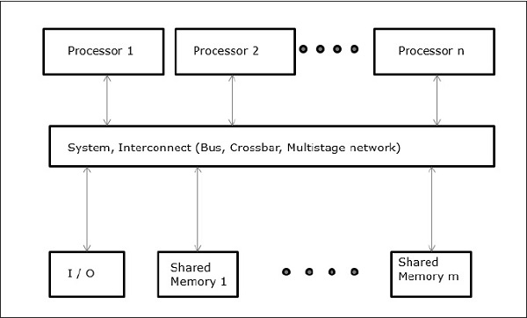
Model of Multiprocessor
Uniform Memory Access
In this model, all the processors share the physical memory uniformly. All the processors have equal access time to all the memory words.
Each processor may have a private cache memory. Same rule is followed for peripheral devices.
When all the processors have equal access to all the peripheral devices, the system is called a symmetric multiprocessor.
When only one or a few processors can access the peripheral devices, the system is called an asymmetric multiprocessor

Slide 12
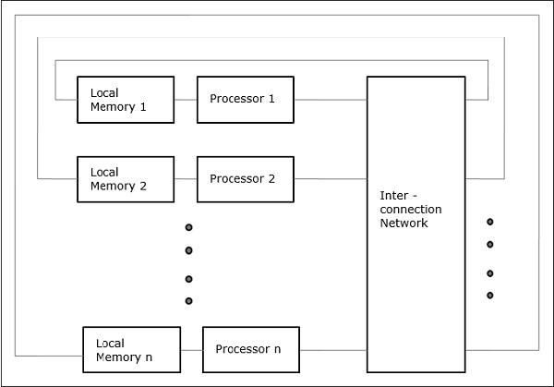
Model of Multiprocessor
Non-uniform Memory Access (NUMA)
In NUMA multiprocessor model, the access time varies with the location of the memory word.
Here, the shared memory is physically distributed among all the processors, called local memories.
The collection of all local memories forms a global address space which can be accessed by all the processors.

Slide 13
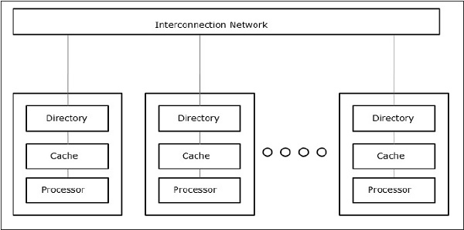
Model of Multiprocessor
Cache Only Memory Architecture (COMA)
The COMA model is a special case of the NUMA model. Here, all the distributed main memories are converted to cache memories

Slide 14
Model of Distributed System
Resources in a distributed system are shared between users. They are normally encapsulated within one of the computers and can be accessed from other computers by communication.
Each resource is managed by a program, the resource manager; it offers a communication interface enabling the resource to be accessed by its users.
Resource managers can be in general modeled as processes.
If the system is designed according to an object-oriented methodology, resources are encapsulated in objects.
Distributed System Models is as follows:
Architectural Models, Interaction Models, Fault Models

Slide 15
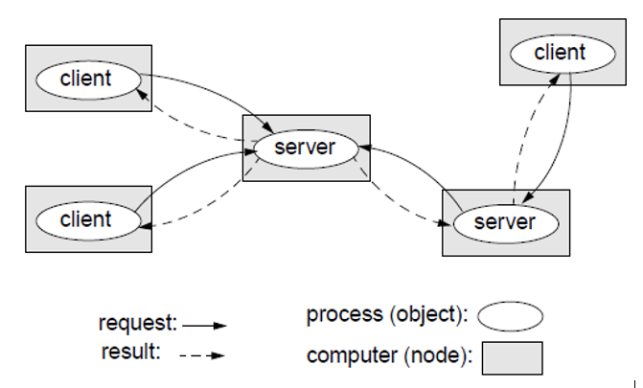
Architectural Models
Architectural model describes responsibilities distributed between system components and how are these components placed.
Client-server model
The system is structured as a set of processes, called servers, that offer services to the users, called clients.
The client-server model is usually based on a simple request/reply protocol, implemented with send/receive primitives or using remote procedure calls (RPC) or remote method invocation (RMI):
The client sends a request (invocation) message to the server asking for some service;
The server does the work and returns a result (e.g. the data requested) or an error code if the work could not be performed.
A server can itself request services from other servers; thus, in this new relation, the server itself acts like a client.

Slide 16
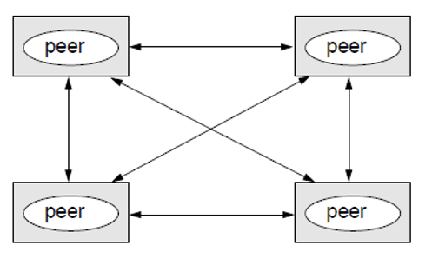
Architectural Models
Peer-to-peer
All processes (objects) play similar role.
Processes (objects) interact without particular distinction between clients and servers.
The pattern of communication depends on the particular application.
A large number of data objects are shared; any individual computer holds only a small part of the application database.
Processing and communication loads for access to objects are distributed across many computers and access links.
This is the most general and flexible model.
Peer-to-Peer tries to solve some of the above
It distributes shared resources widely -> share computing and communication loads.

Slide 17
Interaction Model
Interaction model are for handling time i. e. for process execution, message delivery, clock drifts etc.
Synchronous distributed systems
Main features:
Lower and upper bounds on execution time of processes can be set.
Transmitted messages are received within a known bounded time.
Drift rates between local clocks have a known bound.
Important consequences:
In a synchronous distributed system there is a notion of global physical time (with a known relative precision depending on the drift rate).
Only synchronous distributed systems have a predictable behavior in terms of timing. Only such systems can be used for hard real-time applications.
In a synchronous distributed system it is possible and safe to use timeouts in order to detect failures of a process or communication link.
It is difficult and costly to implement synchronous distributed systems.
Asynchronous distributed systems
Many distributed systems (including those on the Internet) are asynchronous. - No bound on process execution time (nothing can be assumed about speed, load, and reliability of computers). - No bound on message transmission delays (nothing can be assumed about speed, load, and reliability of interconnections) - No bounds on drift rates between local clocks.
Important consequences:
In an asynchronous distributed system there is no global physical time. Reasoning can be only in terms of logical time (see lecture on time and state).
Asynchronous distributed systems are unpredictable in terms of timing.
No timeouts can be used.
Asynchronous systems are widely and successfully used in practice.
In practice timeouts are used with asynchronous systems for failure detection.
However, additional measures have to be applied in order to avoid duplicated messages, duplicated execution of operations, etc.

Slide 18
Fault Models
Failures can occur both in processes and communication channels. The reason can be both software and hardware faults.
Fault models are needed in order to build systems with predictable behavior in case of faults (systems which are fault tolerant).
such a system will function according to the predictions, only as long as the real faults behave as defined by the “fault model”

Slide 19
Further Readings
Brian W. Kernighan and Dennis M. Ritchie, The C Programming Language, Prentice Hall, 1988.
Data Structures and Algorithms; Shi-Kuo Chang; World Scientifi c.
Data Structures and Effi cient Algorithms, Burkhard Monien, Thomas Ottmann, Springer.
Kruse Data Structure & Program Design, Prentice Hall of India, New Delhi
Mark Allen Weles: Data Structure & Algorithm Analysis in C Second Adition. Addison-Wesley publishing
RG Dromey, How to Solve it by Computer, Cambridge University Press.
Shi-kuo Chang, Data Structures and Algorithms, World Scientifi c
Sorenson and Tremblay: An Introduction to Data Structure with Algorithms.
Thomas H. Cormen, Charles E, Leiserson & Ronald L. Rivest: Introduction to Algorithms.
Prentice-Hall of India Pvt. Limited, New Delhi Timothy A. Budd, Classic Data Structures in C++, Addison Wesley

